Slide 1
09-11 Numerical Simulations of motion

Slide 2
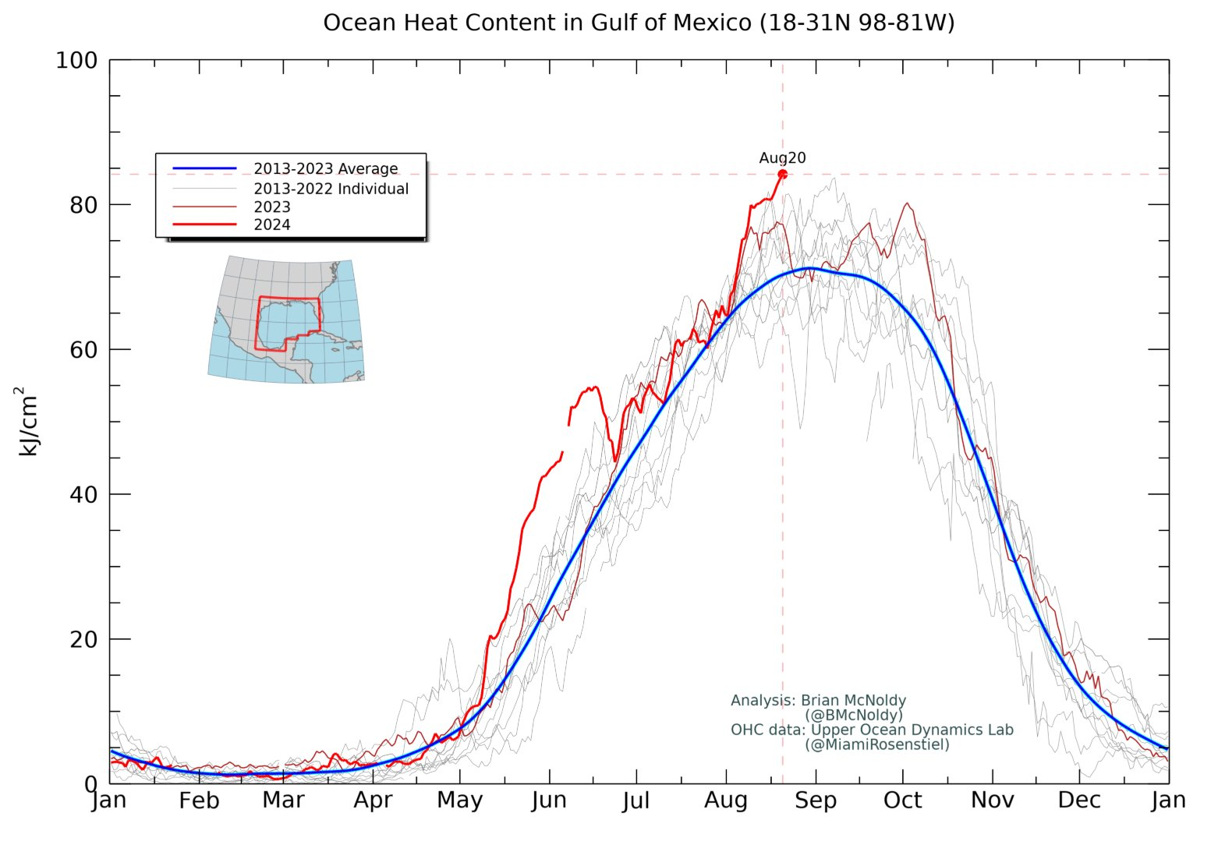
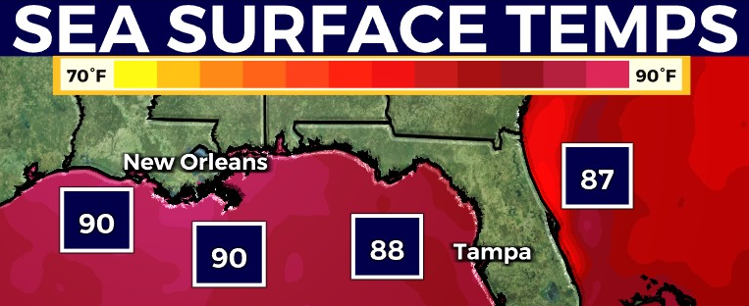

What will the weather be like tomorrow?
Notes:
Taylor series

Slide 3





What will the weather be like: 1. tomorrow? 2. in a week? 3. in a year?
Notes:
Taylor series

Slide 4




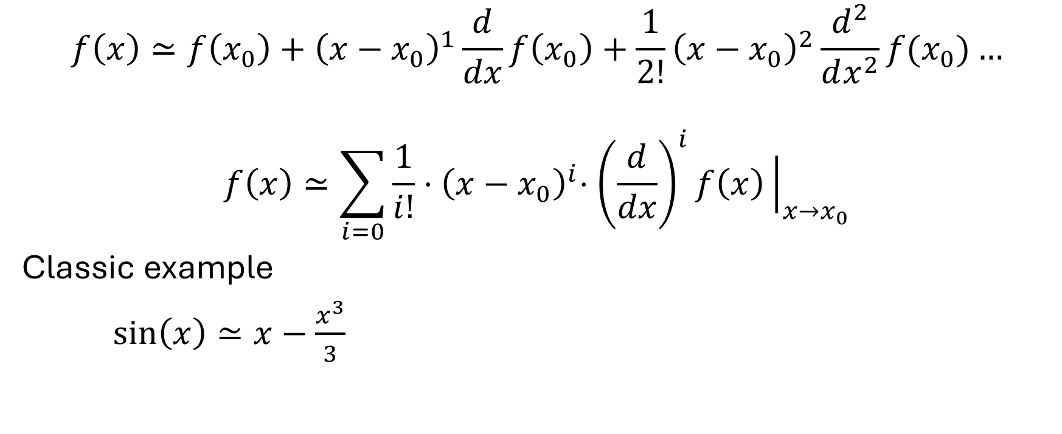



Taylor Series Expansions are all over physics
$$f\left(x\right)≃f\left(x_{0}\right)+{\left(x−x_{0}\right)}^{1}\frac{d}{dx}f\left(x_{0}\right)+\frac{1}{2!}{\left(x−x_{0}\right)}^{2}\frac{d^{2}}{dx^{2}}f(x_{0})…$$
$$f\left(x\right)≃\sum_{i=0}{\frac{1}{i!}{⋅\left(x−x_{0}\right)}^{i}⋅{\left(\frac{d}{dx}\right)}^{i}f\left(x\right){\left.​\right|}_{x→x_{0}}}$$
Classic example
$\sin\left(x\right)≃x−\frac{x^{3}}{3}$

Slide 5







